Slide 1
A Primer on Conic Sections part three Ellipses
Presented at the MN State HS Mathematics League
Coaches Conference
October 3rd, 2020
by
Tom Young, Executive Director

Slide 2
What is an Ellipse?
Geometric definition:
An ellipse is a conic section where a plane, oblique to the bases of a double cone, intersects a double cone and creates a closed curve.
The plane does not intersect the double cone at its apex

Slide 3
We can mathematically define conic sections (in the Euclidean plane) in a couple of ways Note: many of the applications of conics come from their 3-dimensional analogs In Math League, we study the 2-dimensional Cartesian planar conics
As a locus of points
Using definitions of distance
Using the idea of eccentricity and distance from focal point to directrix
Algebraically
Circles are planar curves that fit the definition
Ax² + Cy² + Dx + Ey + F = 0 where A = C where A and C ≠ 0

Slide 4
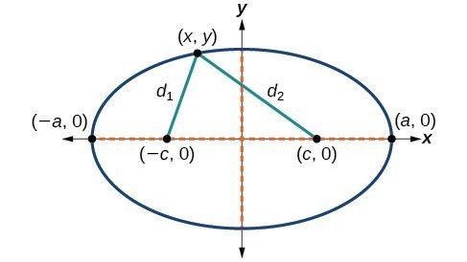
Conic sections as a locus of points
An ellipse can be defined as the curve surrounding two focal points, F₁ and F₂ , such that for all points P on the curve, the sum of the two distances to the focal points is a constant
That is, PF₁+ PF₂ = d₁ + d₂ = constant
P
It will be shown that the constant is 2a
That is, d₁ + d₂ = 2a
F₂
F₁

Slide 5
We can mathematically define conic sections (in the Euclidean plane) in a couple of ways Note: many of the applications of conics come from their 3-dimensional analogs In Math League, we study the 2-dimensional Cartesian planar conics
As a locus of points
Using definitions of distance
Using the idea of eccentricity and distance from focal point to directrix
Algebraically
Circles are planar curves that fit the definition
Ax² + Cy² + Dx + Ey + F = 0 where A = C where A and C ≠ 0

Slide 6
Conic sections as a locus of points Using the idea of eccentricity and distance from focal point to directrix
Define a point F to be the focal point
Define a line L to be the directrix
Define a point P to be on the conic
P is on the conic if the distance FP divided by the distance LP = constant.
That is, $\frac{FP}{LP}=e$
This is constant is known as the eccentricity, e, of the conic.
If e = 0, the conic is a circle (the limiting case of an ellipse)
If 0 < e < 1, the conic is an ellipse
If e = 1, the conic is a parabola
If e > 1, the conic is a hyperbola

Slide 7
Finding an ellipse using
the idea
of eccentricity
8
6
e = 1/2
4
3
2
4
F₂
F₁
P
F₁P/LP = 1/2
L
Ellipse!
By symmetry, we could have
created the same ellipse
with another focal point and
another directrix

Slide 8
We can mathematically define conic sections (in the Euclidean plane) in a couple of ways Note: many of the applications of conics come from their 3-dimensional analogs In Math League, we study the 2-dimensional Cartesian planar conics
As a locus of points
Using “common” definitions of distance
Using the idea of eccentricity and distance from focal point to directrix
Algebraically
Circles are planar curves that fit the definition
Ax² + Cy² + Dx + Ey + F = 0 where A = C where A and C ≠ 0

Slide 9
Recognizing the different conics from their algebraic definition
Ax² + Bxy + Cy² + Dx + Ey + F = 0 General form
In concert with the other terms, the term Bxy does weird things to the graphs:
it can make the conic slanted (x² – 7xy + 13y² = 4),
it can cause the graph to degenerate to a line (x² – 2xy + y² = 0),
it can create two || lines (x² – 2xy + y² = 4),
it can create intersecting lines (x² – 4xy + y² = 0),
it can cause what you think is an ellipse to be a hyperbola (x² – 7xy + 2y² = 4)
hard to predict based on the interactions with the other terms.
So for most of this discussion, we are going to assume B = 0. Math League rarely uses conics with a B value but we will show a couple of examples later

Slide 10
Recognizing the different conics from their algebraic definition
Ax² + Cy² + Dx + Ey + F = 0 General form, where B = 0
If A = C = 0 and D, E not both zero, the graph is a line
If A = C, the graph is a usually a circle (degenerate cases can occur depending on D, E, F… e.g x² + y² + 8 = 0)
If A ≠ C, and A and C have the same sign, the graph is a usually an ellipse
(degenerate cases can occur depending on D, E, F… e.g x² +5y² -x+y+3=0)
If A ≠ C,and A and C have the different signs, the graph is a usually a hyperbola
(degenerate cases can occur depending on D, E, F… e.g x² + 20x + 100 – y² = 0)
If A or C = 0 (but not both), the graph is a parabola (I am not aware of degenerate cases)

Slide 11
Definitions we can use in conics
In addition to the eccentricity (e), foci, and directrix, various
geometric features and lengths are associated with a conic section.
The principal axis is the line joining the foci of an ellipse or hyperbola,
and the midpoint of the foci is the curve's center. A parabola has no center.
The linear eccentricity, c, is the distance between the center and a focus.
The latus rectum, 2L is the chord parallel to the directrix and passing
through a focus; its half-length L is the semi-latus rectum.
The focal parameter, p, is the distance from a focus to the corresponding directrix.

Slide 12
Definitions we can use in conics
The major axis, is the chord between the two vertices:
the longest chord of an ellipse,
The minor axis is the shortest diameter of an ellipse.
The minor axis connects the co-vertices.

Slide 13
Relationships we can use in conics
L = p•e the semi-latus rectum is the distance from
the focus to the directrix multiplied by the eccentricity
c = a•e the distance from the center to the focus is the vertex
distance multiplied by the eccentricity
p + c = $\frac{a}{e}$ the distance from the focus to the directrix plus the focal
distance (the distance from the center to the focus)
equals the vertex distance divided by the eccentricity

Slide 14
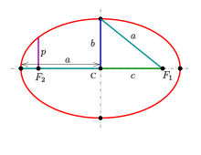
p + c = $\frac{a}{e}$
c = a•e
L = p•e
L
p
directrix

Slide 15
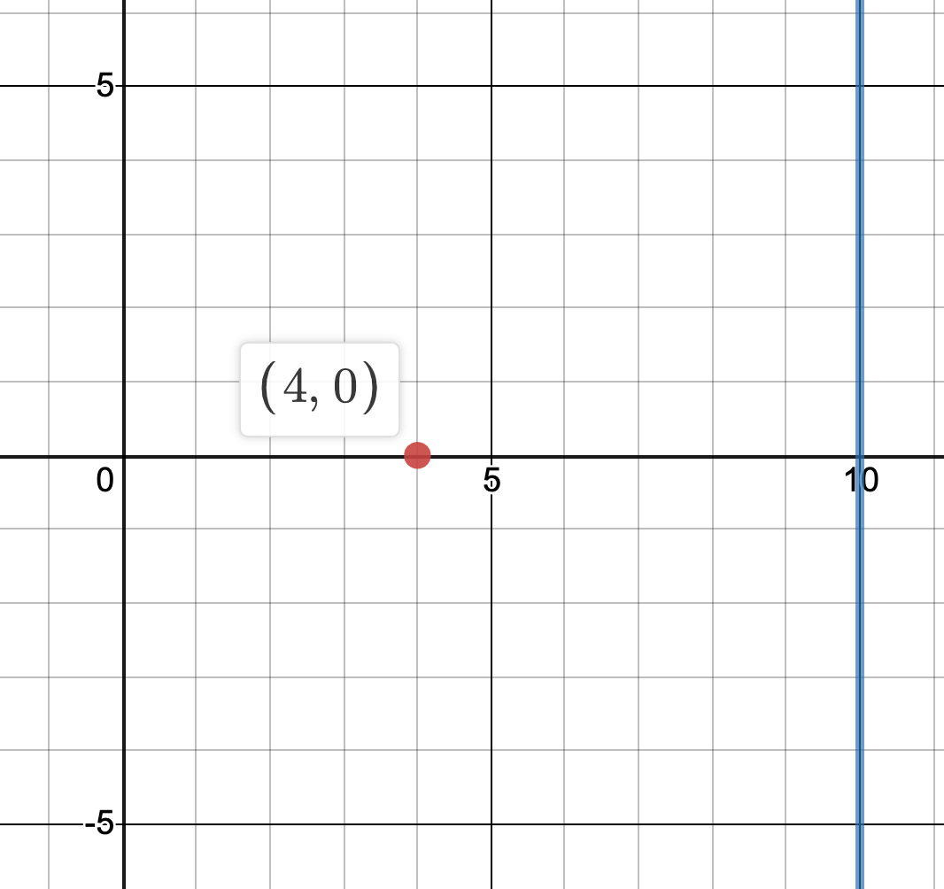
Let’s show that those formulas work
Find the equation of an ellipse with focus (4,0), directrix x = 10, and eccentricity = 1/2
Sketch
We want a point P(x,y)
where FP/LP = 1/2
P(x,y)
F
L

Slide 16
Let’s show that those formulas work
Find the equation of an ellipse with focus (4,0),
directrix x = 10, and eccentricity = 1/2
FP = $\sqrt{\left(x−4\right)2+\left(y−0\right)2}$ PL = |x–10|
P(x,y)
F
L
$\frac{FP}{PL}$ = $\frac{\sqrt{\left(x−4\right)2+\left(y−0\right)2}}{|x −10|}=$ $\frac{1}{2}$
4[x² – 8x + 16] + 4y² = x² – 20x +100
4x² – 32x + 64 + 4y² = x² – 20x +100
3x² – 12x – 36+ 4y² = 0
2 $\sqrt{\left(x−4\right)2+\left(y\right)2 }$ = |x – 10 |
3(x² – 4x + 4) + 4y² = 36 + 12
4 [$\left(x−4\right)2+\left(y\right)2$] = (x – 10)²
$\frac{\left(x−2\right)2}{16}$ + $\frac{\left(y\right)2}{12}$ = 1

Slide 17
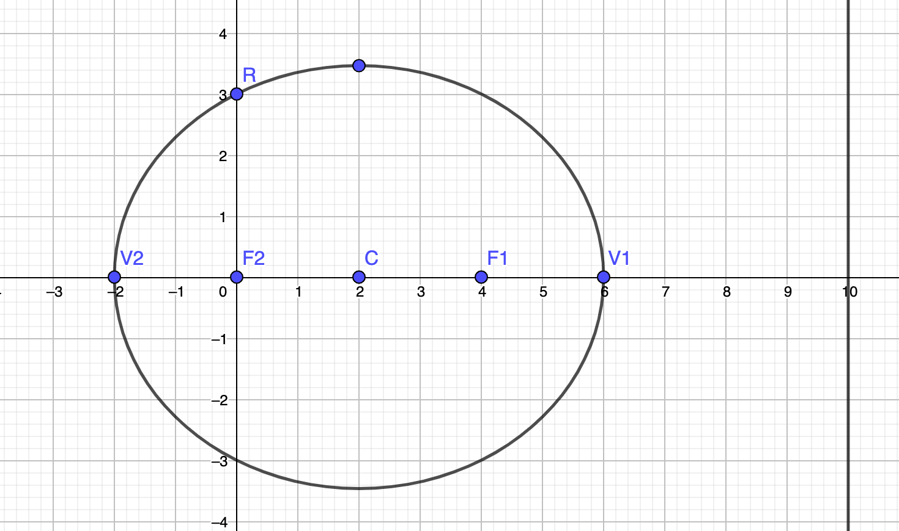
Let’s show that those formulas work
Find the equation of an ellipse with focus (4,0), directrix x = 10, and eccentricity = 1/2
$\frac{\left(x−2\right)2}{16}$ + $\frac{\left(y\right)2}{12}$ = 1
3x² – 12x – 36+ 4y² = 0
L
p
directrix
L = p•e 3 = 6 • ½
c = a•e 2 = 4 • 1/2
p + c = $\frac{a}{e}$ 6 + 2 = $\frac{4}{\frac{1}{2}}$
e = ½ p = 6 c = 2 a = 4 L = 3
In a “tall” ellipse replace a with b

Slide 18
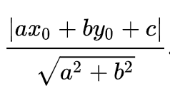
A problem with Bxy
Find the equation of an ellipse with eccentricity = ½, the focal point = (4,0) and the directrix x + 2y = 10
NEED formula for distance from a point (x₀,y₀) to line ax + by + c = 0
Given without proof d =

Slide 19
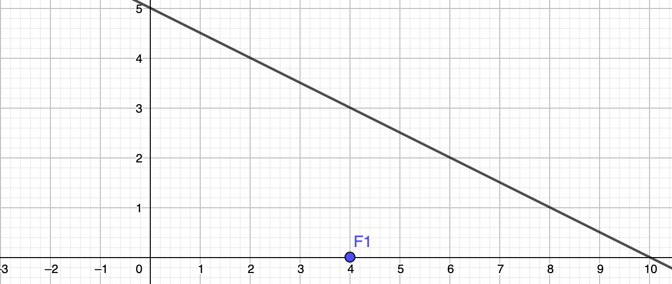
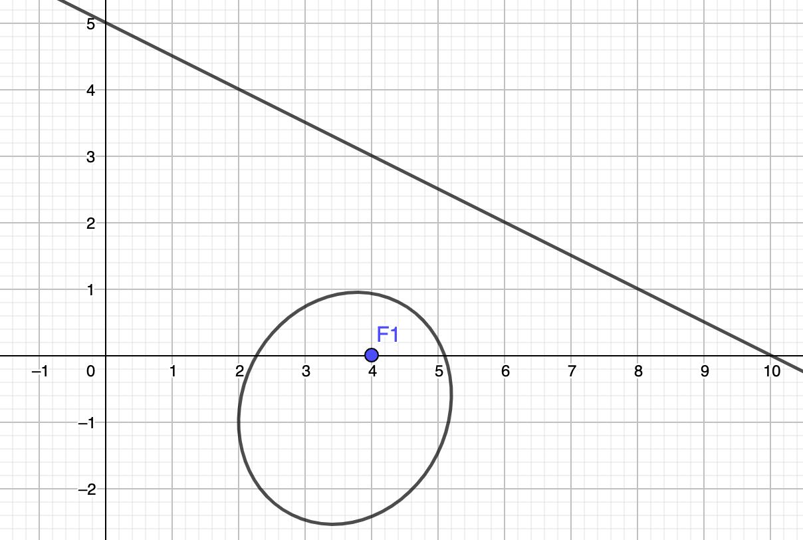
A problem with Bxy
Find the equation of an ellipse with focus (4,0), directrix x+2y = 10,
and eccentricity = 1/2
FP = $\sqrt{\left(x−4\right)2+\left(y−0\right)2}$ PL = $\frac{|1x+2y −10|}{\sqrt{5}}$
(x,y)
$\frac{FP}{PL}$ = $\frac{\sqrt{\left(x−4\right)2+\left(y−0\right)2}}{\frac{|1x+2y −10|}{\sqrt{5}}}=$ $\frac{1}{2}$
20[x² – 8x + 16] + 20y² = x² + 4xy – 20x – 40y + 4y² + 100
20x² – 160x + 320 + 20y² = x² + 4xy – 20x – 40y + 4y² + 100
19x² – 4xy – 140x + 40y + 16y² + 220 = 0
2 $\sqrt{\left(x−4\right)2+\left(y\right)2 }$ = $\frac{|1x+2y −10|}{\sqrt{5}}$
4 [$\left(x−4\right)2+\left(y\right)2$] = $\frac{\left(1x+2y −10\right)2}{5}$

Slide 20
Typically Math League deals with ellipses in standard form. This from Wikipedia

Slide 21
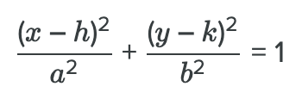
Standard Forms of an Ellipse
c² = | a² – b² | when a > b wider than taller
when a < b taller than wider
L

Slide 22
Ellipse Problems from last 20+ years
1999 – 2000 #1
2002 – 2003 #3
2008 – 2009 #2
20019 – 2011 #4
2013 – 2014 #2 and #4
2014 – 2015 #3 and #4
2016 – 2017 #2 and #4
2018 – 2019 #4
2019 – 2020 #3

Slide 23
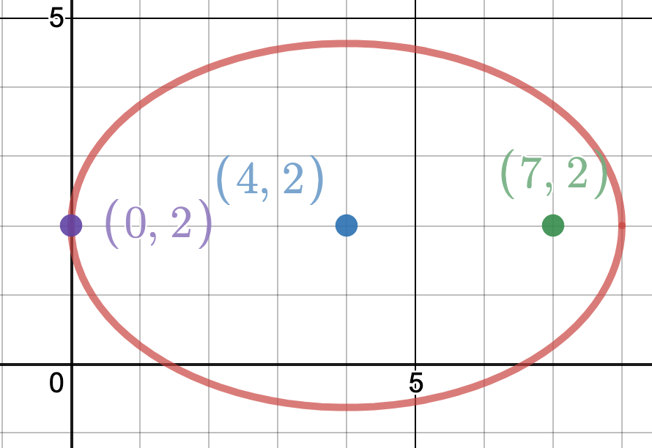
2008 – 2009 #2
Note, since center and focus are on a
horizontal line, the ellipse must be
wider than it is taller. Therefore a > b
Quick sketch
a = 4, c = 3
c² = |a² – b²| or 9 = |16 – b²|
b² could be 7 or 25, but since b < a,
it must be 7. Therefore b = $\sqrt{7}$
So minor axis = 2$\sqrt{7}$

Slide 24
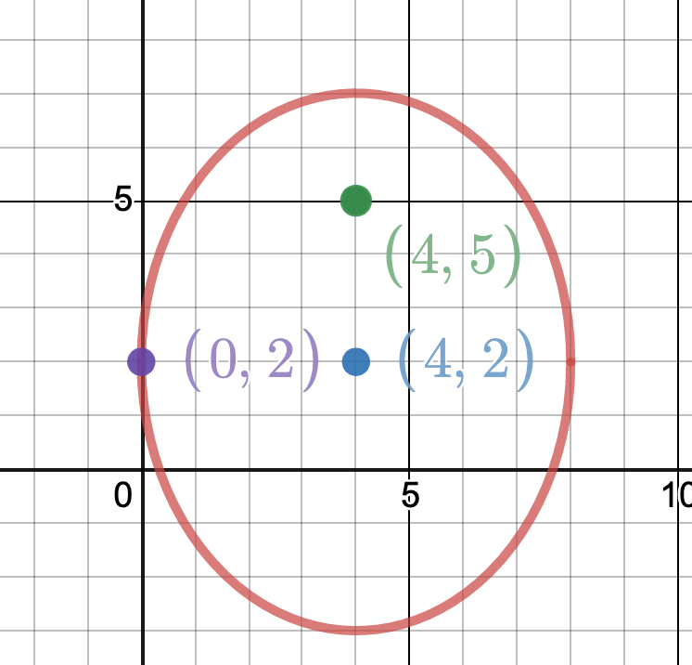
2008 – 2009 #2 alternate version
(4,5)
Note, since center and focus are on a
vertical line, the ellipse must be
taller than it is wider. Therefore b > a
Quick sketch
a = 4, c = 3
c² = |a² – b²| or 9 = |16 – b²|
b² could be 7 or 25, but since b > a,
it must be 25. Therefore a = $\sqrt{16}$
So minor axis = 8
But we should have known that already!

Slide 25
2008 – 2009 #2 alternate version
(4,5)
Challenge: show that the directrix is y = 31/3
Quick sketch
L = p•e 3.2 = 16/3 • 3/5
c = b •e 3 = 5 • e therefore e = 3/5
p + c = $\frac{b}{e}$ 16/3 + 3 = $\frac{5}{\frac{3}{5}}$

Slide 26
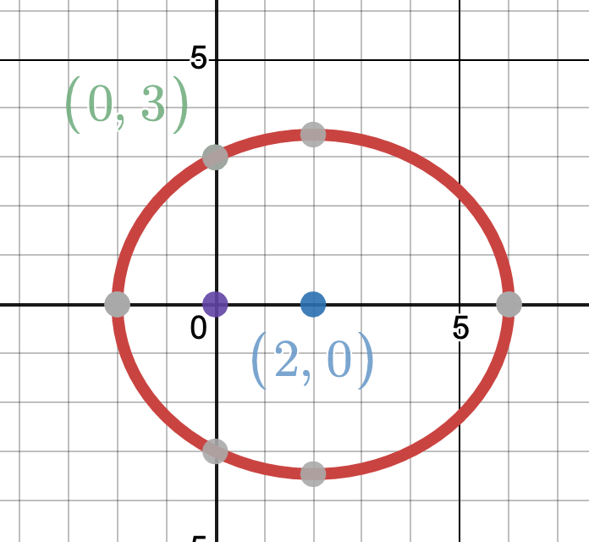
2010 – 2011 #4
Where A(2,0) and B (0,3)
Sketch
One solution:
we know the form of the equation is
$\frac{\left(x−2\right)2 }{a^{2}}$ + $\frac{\left(y\right)2}{b^{2}}$ = 1
And since it’s oriented horizontally (“follow the foci”) a > b so c² = a² – b²
But c = 2 therefore 4 = a² – b² or b² = a² - 4
Since (0,3) is on the conic $\frac{\left(0−2\right)2 }{a^{2}}$ + $\frac{\left(3\right)2}{a^{2}−4}$ = 1
Solving for a leads to a⁴ – 17a² + 16 = 0 so a = 4
Therefore the equation is $\frac{\left(x−2\right)2 }{{16}^{}}$ + $\frac{\left(y\right)2}{12}$ = 1

Slide 27
2010 – 2011 #4 Alternat solution
Where A(2,0) and B (0,3)
Sketch
Alternate solution:
we know the form of the equation is
$\frac{\left(x−2\right)2 }{a^{2}}$ + $\frac{\left(y\right)2}{b^{2}}$ = 1
Since center is at (2,0) and one focus at (0,0) other at (4,0)
By definition, an ellipse is all points who sum of distances
to focal points is constant = 2a
f₂
f₁
But (0,3) is 3 from f₂ and 5 from f₁ (3-4-5 triangle) so 2a = 8
So a = 4 c² = a² – b² 2² = 4² – b² or b² = 12
Therefore the equation is $\frac{\left(x−2\right)2 }{{16}^{}}$ + $\frac{\left(y\right)2}{12}$ = 1

Slide 28
2014 – 2015 #4
Sketch

Slide 29
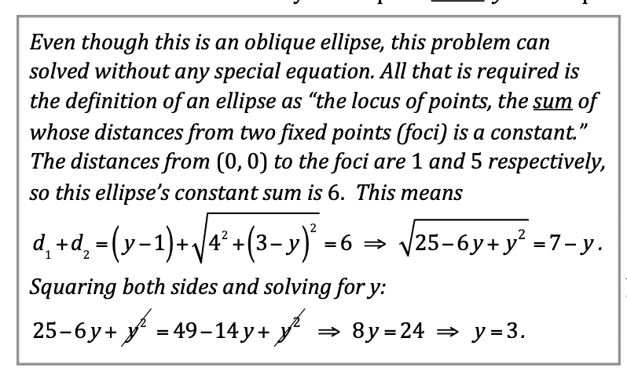
2014 – 2015 #4
Sketch

Slide 30
A prepared Math Teamer should look at this problem and be confident
Find the center, the foci, and the two vertices of the ellipse:
2x² + 8x + 6y² – 12y – 22 = 0

Slide 31
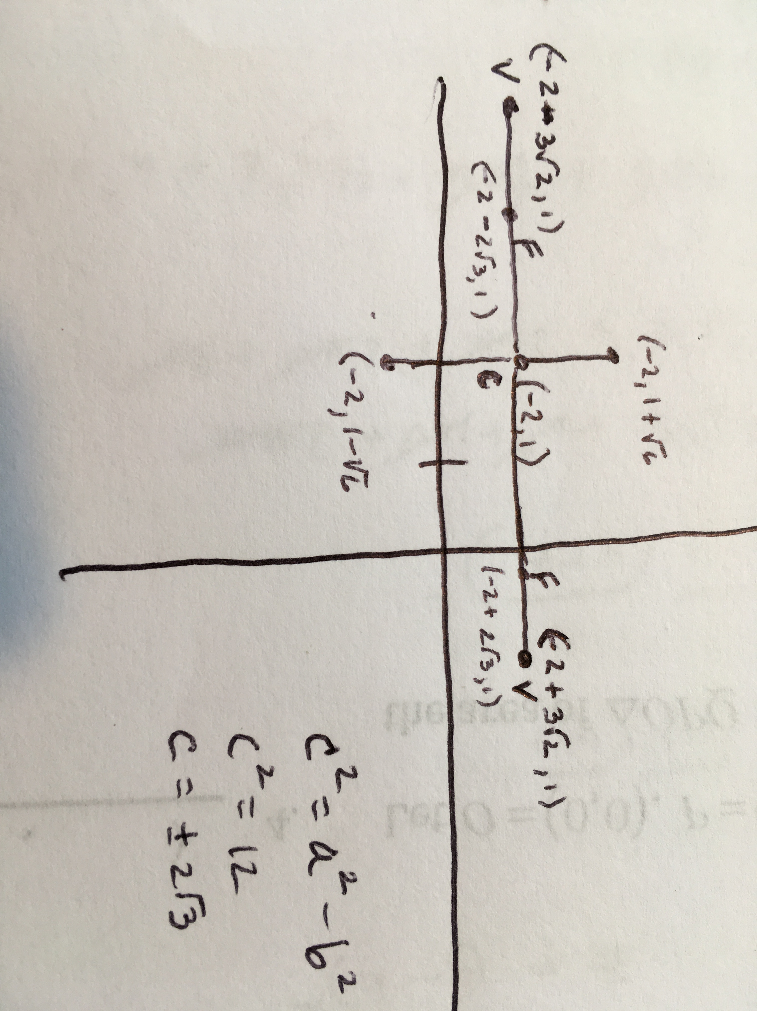
Find the center, the foci, and the two vertices of the ellipse:
2x² + 8x + 6y² – 12y – 22 = 0
2(x² + 4x + 4) + 6(y² – 2y + 1) = 22 + 14
2(x + 2)² + 6(y – 1 )² = 36
$\frac{{(x+2)}^{2}}{18}$ + $\frac{{(y–1)}^{2}}{6}$ = 1
a = $\sqrt{18 }= 3\sqrt{2}$
b = $\sqrt{6 }$
c² = 18 – 6 = 12 so c = $2\sqrt{3}$

Slide 32
Find the Latus Rectum of the ellipse
In an ellipse , the semi – latus rectum = (b^2)/a
$\frac{{(x+2)}^{2}}{18}$ + $\frac{{(y–1)}^{2}}{6}$ = 1
a =$3\sqrt{2}$
b² = 6
Semi - Latus rectum = $\frac{6}{{(3\sqrt{2})}^{}}$ = $\sqrt{2}$ therefore the latus rectum is 2 $\sqrt{2}$

Slide 33
Technology
See web page at
Ellipse Calculator

Slide 34
This is the end of part three
In separate PowerPoints, we will examine each conic separately, working on the details of each particular conic and doing more examples from the Math League canon

