Slide 1
A Primer on Conic Sections part two Circles
Presented at the MN State HS Mathematics League
Coaches Conference
October 3rd, 2020
by
Tom Young, Executive Director

Slide 2
What is a Circle?
Geometric definition:
A circle is a conic section where a plane, parallel to the bases of a double cone, intersects a double cone. The plane does not intersect the double cone at its apex

Slide 3
We can mathematically define conic sections (in the Euclidean plane) in a couple of ways Note: many of the applications of conics come from their 3-dimensional analogs In Math League, we study the 2-dimensional Cartesian planar conics
As a locus of points
Using definitions of distance
Using the idea of eccentricity and distance from focal point to directrix
Algebraically
Circles are planar curves that fit the definition
Ax² + Cy² + Dx + Ey + F = 0 where A = C where A and C ≠ 0

Slide 4
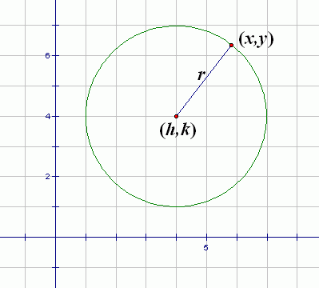
Conic sections as a locus of points
A circle can be defined as all points in a plane a constant distance from a focal point, known as the center of the circle. The constant distance is called the radius of the circle
Some students mistakenly think a circle is
all the points on the circle and inside the circle.
Mathematically speaking, that is incorrect.
A circle consists of all the points on the circle,
not inside.

Slide 5
We can mathematically define conic sections (in the Euclidean plane) in a couple of ways Note: many of the applications of conics come from their 3-dimensional analogs In Math League, we study the 2-dimensional Cartesian planar conics
As a locus of points
Using “common” definitions of distance
Using the idea of eccentricity and distance from focal point to directrix
Algebraically
Circles are planar curves that fit the definition
Ax² + Cy² + Dx + Ey + F = 0 where A = C where A and C ≠ 0

Slide 6
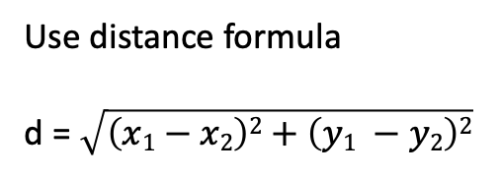

Algebraic formula from Locus of Points definitions: Circle, center (h,k) “distance from P to Center, O, is constant radius”
Use distance formula
d = $\sqrt{\left(x1−x2\right)2+\left(y1 −y2\right)2}$
r² = $\left(x−h\right)2+\left(y −k\right)2$
r² = $\left(x2 −2hx+h2\right)+\left(y2 −2ky+k2\right)$
0 = $\left(x2+y2−2hx –2ky+h2+k2 −r2\right)$
0 = $x2+y2−2hx –2ky+h2+k2 −r2$
0 = A$x2+Bxy+Cy2+Dx+Ey+F$
where A = 1, B = 0, C = 1, D = –2h, E = –2k F = $h2+k2 −r2$
P
O

Slide 7
Some of the Math team problems in the last 20 years involving circles
2015 0 2016 #4
2014 – 2015 #2
2009 – 2010 #2
2008 – 2009 #3
2007 – 2008 All
2004 – 2005 #4
2003 – 2004 #4
2000 – 2001 All
A common theme: tangents to circles and circles tangent to an axis
Case in point 2004 – 2005 #4

Slide 8
2004 – 2005 Meet 4 #4D
The circle x² + y² = 25 passes through (0,5) and (3,4) and is tangent to the line y + 5 = 0. Find the radius of a second circle with the same properties
First thing to do:
draw a quick sketch
that’s fairly accurate

Slide 9
2004 – 2005 Meet 4 #4D
The circle x² + y² = 25 passes through (0,5) and (3,4) and is tangent to the line y + 5 =0. Find the radius of a second circle with the same properties
Second thing to do:
Imagine where the
other circle must lie
(h,k)

Slide 10
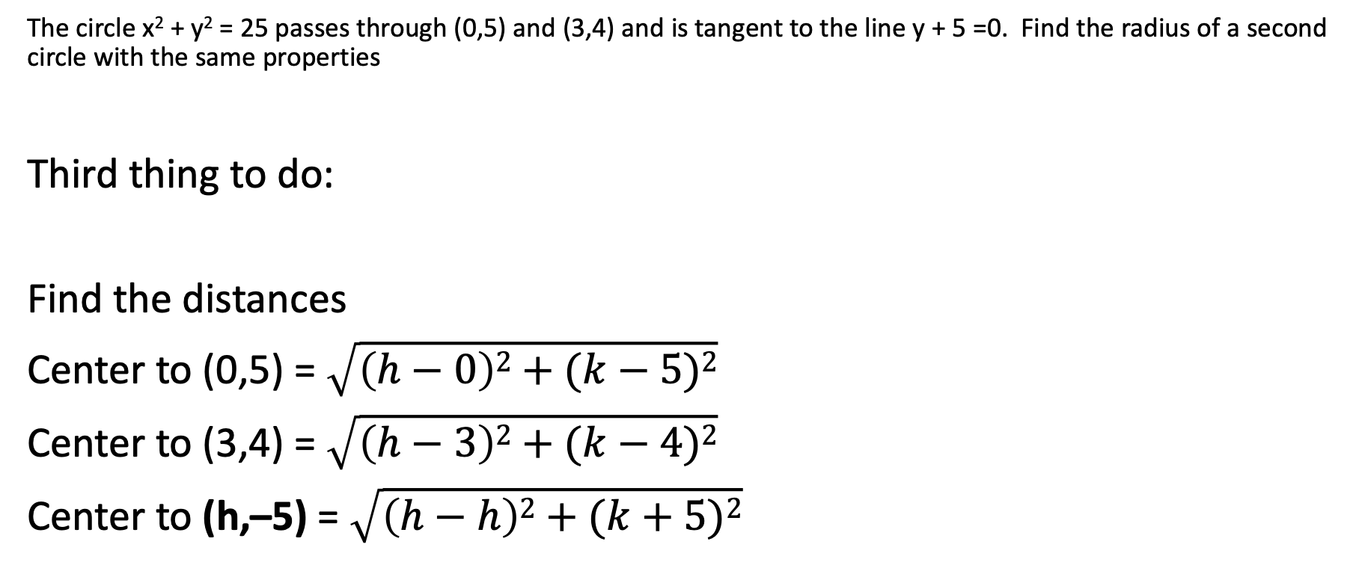
2004 – 2005 Meet 4 #4D
The circle x² + y² = 25 passes through (0,5) and (3,4) and is tangent to the line y + 5 =0. Find the radius of a second circle with the same properties
Third thing to do:
Find the distances
Center to (0,5) = $\sqrt{\left(h−0\right)2+(k−5)2}$
Center to (3,4) = $\sqrt{\left(h−3\right)2+(k−4)2}$
Center to (h,–5) = $\sqrt{\left(h−h\right)2+(k+5)2}$
(h,k)
(h,–5)

Slide 11
2004 – 2005 Meet 4 #4D
The circle x² + y² = 25 passes through (0,5) and (3,4) and is tangent to the line y + 5 =0. Find the radius of a second circle with the same properties
Fourth thing to do: the distances must be equal since they are radii
$\sqrt{\left(h−0\right)2+(k−5)2}$ = $\sqrt{\left(h−3\right)2+(k−4)2}$ = $\sqrt{\left(h−h\right)2+(k+5)2}$
h² + k² – 10k + 25 = h² – 6h + 9 + k² – 8k + 16 by working with first two
–2k = – 6h
k = 3h the rest is algebra which results in h = 60, k = 180

Slide 12
2004 – 2005 Meet 4 #4D
The circle x² + y² = 25 passes through (0,5) and (3,4) and is tangent to the line y + 5 =0. Find the radius of a second circle with the same properties
Fifth thing to do: but it asks for the radius!!
Some students would use the
center (60, 180) and the
point (0,5) and try the
distance formula
But isn’t the radius just 5 more than k?
Therefore r = 185
(h,k)
(h,–5)

Slide 13
2004 – 2005 Meet 4 #4D
The circle x² + y² = 25 passes through (0,5) and (3,4) and is tangent to the line y + 5 =0. Find the radius of a second circle with the same properties
Sketch
Imagine
Attack
Summarize
Inspect
(h,k)
(h,–5)

Slide 14
Important Geometric property of a circle
The radius (and therefore the diameter)
is perpendicular to a tangent at the point of tangency

Slide 15
Important Geometric corollary
The center of another circle, tangent at the point of tangency,
lies on the diameter of the original circle.
That is, the centers are collinear

Slide 16
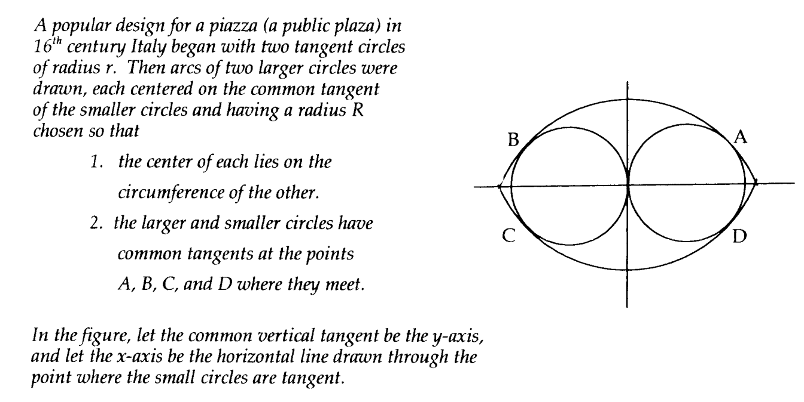
2007 – 2008 Meet 4D

Slide 17
2007 – 2008 Meet 4D

Slide 18
2007 – 2008 Meet 4D
The circle is centered at (r,0) with a radius of r
Use equations you know
r² = $\left(x−h\right)2+\left(y −k\right)2$
(r,0)
Apply them
r² = $\left(x−r\right)2+\left(y −0\right)2$
Finalize
r² = $\left(x−r\right)2+\left(y \right)2$

Slide 19
2007 – 2008 Meet 4D
Identify important parts and label them
Look for a connection
r² + ${\left(\frac{\text{R}}{\text{2}}\right)}^{2}=$ (R – r)²
r
r
Churn
r² + $\left(\frac{{\text{R}}^{2}}{\text{4}}\right) =$ R² – 2Rr + r²
$$\frac{\text{R}}{\text{2}}$$
R-2r
$\left(\frac{{\text{R}}^{2}}{\text{4}}\right) =$ R² – 2Rr
$\left(\frac{\text{R}}{\text{4}}\right) =$ R – 2r
$\left(\frac{\text{−3}\text{R}}{\text{4}}\right) =$ – 2r
R = $\frac{\text{8}\text{r}}{\text{3}}$

Slide 20
2007 – 2008 Meet 4D
Draw on previous knowledge
The center of another circle, tangent at the point of tangency,
lies on the diameter of the original circle.
That is, the centers are collinear
Draw conclusion
Slope of blue line = $\frac{0 −− \frac{R}{2}}{r −0}$ = $\frac{R}{2r }$
(r,0)
Considered rare, use previous answer
Slope of blue line = $\frac{R}{2r }$= $\frac{\frac{8r}{3}}{2r }$ = $\frac{4}{3 }$
(0,– $\frac{\text{R}}{\text{2}}$)
Remember that slopes of perpendicular lines are opposite reciprocals
Slope of red line = $\frac{−3}{4 }$

Slide 21


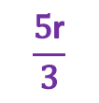
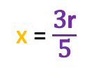
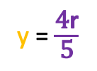
2007 – 2008 Meet 4D
Considered rare, use previous answer
R = $\frac{\text{8}\text{r}}{\text{3}}$
r
y
Remember similar triangles
r
x
$\frac{\frac{4r}{3}}{\text{y}}$ = $\frac{\frac{5r}{3}}{r}$
$\frac{r}{\text{x}}$ = $\frac{\frac{5r}{3}}{r}$
$$\frac{\text{4}\text{r}}{\text{3}}$$
$$\frac{\text{5}\text{r}}{\text{3}}$$
Churn
y = $\frac{\text{4}\text{r}}{\text{5}}$
x = $\frac{\text{3}\text{r}}{\text{5}}$
Answer the question!
Coordinates of A are $\left(\frac{\text{8}\text{r}}{\text{5}},\frac{\text{4}\text{r}}{\text{5}}\right)$

Slide 22
This is the end of part two
In separate PowerPoints, we will examine each conic separately, working on the details of each particular conic and doing more examples from the Math League canon

